Slide 1
Co-op Academy Woodslee Interactive Information Report
February 2024

Slide 2
Contents Page – please click on your preferred option and remember to use the back button.
Co-op Academy Woodslee Information Report
Frequently Asked Questions

Slide 3
Co-op Academy Woodslee Information Report
Return to Contents
Local Authority Offer
Provision for Special Education Needs and Disability at Co-op Academy Woodslee
Information about how we identify, assess and provide provision for childs with special educational needs and how we evaluate our provision.
How do we make provision for childs with SEN and what adaptations may we make to the curriculum.
The name and contact details of the SEND co-ordinator and SEND Governor.
Information about training and expertise of staff with regards to SEND childs.
Equipment and facilities to support childs with SEND at Co-op Academy Woodslee.
What we do to keep our parents and carers informed?
What we do to involve our SEND childs with their education.
What to do as a parent if you have a complaint about SEND at our school
How our Governing body involve health, social care agencies, LA support services and other bodies in meeting the needs of childs with SEND.
The contact details of support services for parents of SEND childs, including those for arrangements made in accordance with section 32.
Co-op Academy Woodslee’s arrangements for supporting childs with SEND in a transfer across phases of education or in preparation for adulthood and independent living.

Slide 4
Back
Provision for Special Education Needs and Disabilities at Co-op Academy Woodslee
At Co-op Academy Woodslee, we aim to offer excellence and choice to all our children, whatever their ability or needs. We have high expectations of all our children. We aim to achieve this through the removal of barriers to learning and participation. We want all our children to feel that they are a valued part of our school community.
We recognise that childs learn at different rates and that there are many factors affecting achievement. We know that children may have difficulties over a short or long period of time, in one or more of these areas:
Cognition and Learning
Sensory and Physical needs
Social, Emotional and Mental Health
Communication and Interaction needs.
We specialise in Social and Communication difficulties and our academy has Local Authority resourced provision which meets the needs of up to 8 children or young people between the ages of 7 and 11 years, who have social and communication difficulties. Small group specialist teaching is offered with many childs having regular opportunities for supported inclusion into the mainstream academy. We also offer specialist teaching in an
additional Key Stage 2 and Early Years / Key Stage 1 small group teaching.

Slide 5
Back
How will Co-op Academy Woodslee identify, assess and provide provision for childs with special educational needs and how do we evaluate our provision?
childs may be identified and assessed as having SEND if their development in any of the four areas mentioned is:
Very different from that of their peers starting from the same baseline
Significantly slower than that they previously attained
A widening of the gap between the child and their peers
Support is required to prevent a progress or developmental gap growing wider.
Advice on how to identify, assess and support childs with SEND comes from internal and external sources such as parents/carers, class teacher, school leadership team, previous educational setting, school nurse, family support workers.
Provision is planned and delivered for all childs by the class teacher - who may have some
additional support such as a teaching assistant. We believe a child’s needs should be identified
and met as early as possible.
Assessment is completed in many forms including data tracking, reviews, observations and parent meetings. childs progress is tracked by the class teacher and evaluated by the school’s leadership team. The effectiveness of SEND provision is regularly monitored by the Senior Leadership Team and governors and is led by Mrs McGowan, the school SENDCo.
Our SEND One Page Policy is shared on the school website alongside all other policies.

Slide 6
Back
How do we make provision for childs with SEND and what adaptations may we make to the curriculum?
Children’s needs are assessed and class teachers plan lessons with all groups of children in mind and will ensure that the curriculum is adapted to suit the needs of individuals. Your child may have additional adults working with him / her both inside and outside of the classroom to help him / her achieve progress.
The class teacher will adapt the curriculum to help all children gain access to the learning. Ways in which this may be done are:
Differentiated / adapted tasks according to ability
Additional adult support
Simple instructions
Task cards
Use of kinaesthetic, visual or auditory resources
Outside agency advice and specific programmes depending on the needs of the individual.
Classrooms can be adapted, for example, we may use a workstation or a quiet area and areas outside of the classroom are used for specific programmes.
There is a disabled toilet with a changing facility.

Slide 7
Back
The name and contact details of the SEND
co-ordinator:
The SENDCo at Co-op Academy Woodslee is Mrs McGowan and our SEND Governor is Mr Mark Kaney
They can be contacted by phone on
0151 334 1406 or
email: woodslee@coopacademies.co.uk

Slide 8
Back
Information about training and expertise of staff with regards to SEND childs.
All of our staff have been trained to deliver High Quality Teaching. We use external agencies to deal with a particular difficulty a child may have and these can include:
Speech and Language Therapists
Autism Team
Edsential – Special Educational Needs Support Service
School Nurse (confidential appointments and support are available from the school nurse. Parents can request an appointment to meet with the school nurse.)
Educational Psychologists – We access the Educational Psychology services. The psychologist will generally meet with the parents for an initial consultation. He/ she will offer advice for the academy and parents/ carers on how to best support the child in order to take their learning forward.
Occupational Therapists
Staff are kept up to date with training through staff meetings and training delivered by either external agencies or our SENDCo. We use a Trauma Informed approach through staff being trained and advised by a clinical psychologist. Our staff have also had training on providing Dyslexia friendly classrooms and different strategies that
can be used for children with reading and spelling difficulties.

Slide 9
Equipment and facilities to support childs with SEND at Co-op Academy Woodslee.
Children will have their support documented through the use of either a one-page profile / additional learning plan, costed provision map or an Education Health and Care Plan.
Learning plans are usually written by the class teacher and detail the support the child will receive within school. Most provision, equipment and facilities on these plans will be devised by the class teacher within the classroom. This will capture the child and parent/carer voice.
For a few children this provision might need to be supported by the SENDCo, who may need to involve other agencies in developing class teaching techniques etc. These recommendations will be shared by the SENDCo with the class teacher, parents / carers and meetings may be arranged up to three times a year to discuss progress.

Slide 10
Equipment and facilities to support childs with SEND at Co-op Academy Woodslee
For childs with a medical condition an Individual Health Care Plan (IHCP) may need to be written with parents/carers and the SENDCo, to guide staff about how to manage these childs needs. childs with more complex medical conditions may need to have a plan written that involves medics who should also attend the meeting. Necessary additional medical advice to support the medical needs would be detailed at these meetings and provided by the medical team. Woodslee also has a small designated medical room that childs may use, if necessary.
If childs’ needs go beyond our school’s expertise, further advice maybe sought from the local authority. Further support for children may be provided by the LA through a child Funding Agreement (PFA) or for those with education, health and care issues an Education, Health Care Plan (EHCP). If a child obtains a PFA / EHCP the Local Authority will look at Woodslee’s facilities and decide on the most appropriate action to support the child – this maybe at Co-op Academy Woodslee or at a specialised base (within school potentially) or alternate provision. For both a PFA and an EHCP childs, parents/carers, schools and other agencies need to work together to achieve a good outcome.
childs may also have additional input/support through the use of child premium money and personal budgets in the future.

Slide 11
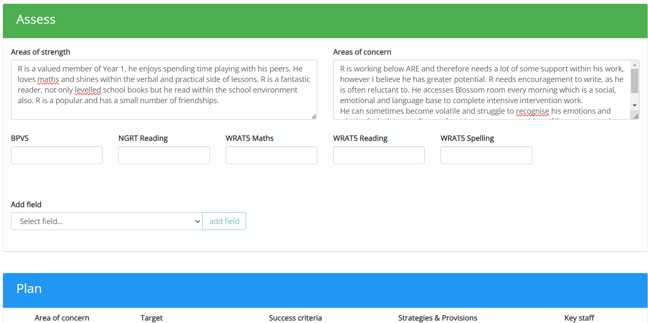
Back
Equipment and facilities to support childs with SEND at Co-op Academy Woodslee
A learning plan will include strengths and areas for development sections as well as an opportunity to capture child and parent/carer voice which we truly value as a school community. There will be targets which are specific, measurable and time monitored with regular chances to review and update throughout the year.
An example of a learning plan following the assess, plan, do, review cycle.

Slide 12
Back
What we do to keep our parents and carers informed?
Parents/carers are always welcome to come into school and make an appointment to see a member of staff to discuss their child and an appointment should be made at the school office.
The senior leadership team are available on the playground in the morning to answer any parent/carer concerns.
We will hold a minimum of 3 termly review meetings where you will be involved in discussions about your child’s progress and the setting of new targets. You will also be involved in the annual review meeting if you have a child with an EHC plan. A child’s views will also be considered at the annual review process and when the class teacher is completing their One Page Profile. Parents will also share their knowledge about their child through completing the transition document. All people present are invited to help develop the support for the child and the child themselves will have the chance to give their views and aspirations.
Parents/carers who have EAL (English as an Additional Language) may wish to
have a translator. Parents/carers may also bring to the meeting a parental
supporter.

Slide 13
Back
What we do to involve our SEND children with their education.
Inclusion is at the heart of everything that Co-op Academy Woodslee does.
Staff will discuss a child’s progress with them and the child’s views will be taken into consideration when discussing progress and target setting.
Children with SEND are encouraged to comment on their plans, they always help to create their own and attend part of their annual PFA or EHCP review meetings.
All staff actively listen to children and endeavour to respond appropriately to their
needs – vocalised or otherwise indicated.

Slide 14
Back
What to do as a parent if you have a complaint about SEND at our school
Initial complaints should be directly raised with the class teacher as most concerns can be quickly ironed out at this stage.
All complaints regarding SEND provision follow the academy’s complaints policy.
If the complaint remains unresolved, the complaint can be forwarded to our Head Teacher. The complaint may be directed by the Head Teacher to the Chair of Governors and/or the Governor for SEND.
Parents will also be advised of their right to refer matters of dispute to the Disagreement Resolution Service. Should action need to be taken the complaints procedure will be followed.
Wirral’s SEND parent partnership is a useful resource and can be accessed on the link below:
http://www.wired.me.uk/Parent-Partnership.asp

Slide 15
Back
How do we involve other bodies, including health and social care bodies, local authority support services and voluntary sector organisations, in meeting children and young people’s SEND and supporting their families?
We work closely with a range of external agencies, please see the list in Section 8.
We signpost families to additional services to help gain the support they may need. The Local Authority’s Local Offer can be accessed via our website and this service signposts parents, carers and school staff to a wide variety of external support and services.
Our families also have access to our Community Care Coordinator,
Ms Claire Rutherford and our Health Care Practitioner, Mrs Alison Leech.
They will provide support where needed and
signpost you to agencies that can help –
a problem shared is a problem halved.

Slide 16
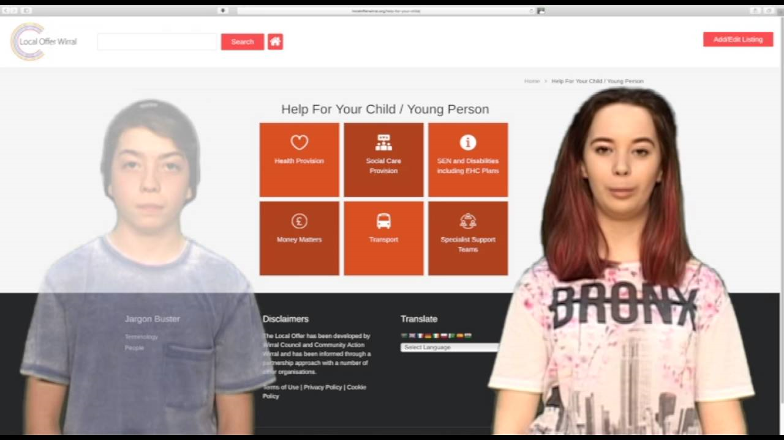
Back
The contact details of support services for parents of children with SEND, including those for arrangements made in accordance with section 32.
These are available through the local authority’s local offer which is published at: http://localofferwirral.org/

Slide 17
Back
How will we prepare and support your child moving to or from our academy? How do we help prepare children for adulthood?
At Woodslee we will try to make any transition as smooth as possible to avoid any additional anxiety for your child.
Parents/carers and a child’s previous setting should inform staff if a child has known SEND.
At foundation stage, Community Care Coordinator/ FS teachers will arrange to visit the preschool/ home. Children will also be invited for a short session in school if appropriate. For children in key stage 1 and key stage 2, visits before the child starts at our school are given and an appointment with the class teacher / SENDCo can be made at any time either in person or by phone to discuss your child.
Our Community Care Coordinator (Miss Rutherford) will conduct home visits for families and encourages visits to the school to improve familiarity with the setting.
Between each class/phase at Woodslee all children are given transition time. Staff will meet to discuss their new children and any additional needs they may have. All official paperwork and records are kept and passed onto the next teacher or setting. Parents are informed of their child’s new class teacher via their child’s end of year report.
For secondary school transfers, year heads, pastoral teams and SENDCos, from the receiving
school, talk to our staff. Additional meetings are held, when felt necessary, which parents and
children are both invited to. For some children, the secondary schools may provide enhanced
transition support which may include additional visits and staff meeting the child individually at
Woodslee in preparation for secondary school, children will engage in learning opportunities relating
to transition and the changes ahead.

Slide 18
Back
Local Authority Offer
The Wirral authority’s local offer is published at: http://localofferwirral.org/

Slide 19
Back
Thank you for looking at our school information report. This next section, frequently asked questions, may help to answer any queries you might have. If you need further information please contact our school by either coming in, phoning 0151 334 1406 or emailing: Woodslee@coopacadmies.co.uk

Slide 20
FREQUENTLY ASKED QUESTIONS (Click on the question you need the answer to)
1. How will you know if my child needs extra help? | 2. What should I do if I think my child may have special educational needs? | 3. How will staff support my child?
4. How will the curriculum be matched to my child’s/young person’s needs? | 5. How will I know how my child is doing and how will you help me to support my child’s/young person’s learning? | 6. What support will there be for my child’s overall well-being?
7. What specialist services and expertise are available or accessed by you? | 8. What training are the staff supporting my child with SEND had or are having? | 9. How will my child be included in activities outside the classroom including school trips?
10. How accessible is your school? | 11. How will you prepare and support my child to join your setting or school and transfer to a new setting or school for the next stage of education and life? | 12. How are your resources allocated and matched to my child’s needs?
13. How is the decision made about what type and how much support my child will receive? | 14. Who can I contact for further information? 16. How will information about the child be circulated to all members of staff and who will be responsible for that? | 15. Can staff get extra help from experts outside if they need to? (eg advice and training on medical conditions)
Return to Contents

Slide 21
Back
How will you know if my child need extra help?
At school, we are constantly assessing your child’s progress both in line with their previous attainment and development and that of their peers, both academic and contextual progress is monitored. If your child appears to be developing at a different rate to expected norms, the class teacher or SENDCo will approach you and discuss any concerns with you.
Concerns may be raised if:
There is little or no progress academically;
Social emotional difficulties are becoming challenging;
Sensory/ physical difficulties become evident;
A specific difficulty is evident in English or maths skills;
Social communication or interaction problems increase despite intervention;
Speech and communication skills do not develop appropriately.

Slide 22
Back
2. What should I do if I think my child may have special educational needs?
Come into school and talk to your child’s class teacher as they will be the person who knows your child best. You may also want to speak to the school SENDCo, Mrs McGowan.

Slide 23
Back
3. How will staff support my child?
We aim to meet the needs of all our children within the classroom through high quality teaching. Some children may require further support within the classroom or school. This support could be delivered by; class teacher, another teacher, teaching assistant or additional staff who are employed by the school through the local authority via the SENDCo.
The resources, staff involved, staff roles and frequency of support offered to your child would be dependent on their needs and this would be clearly shown on your son/daughter’s plan. The learning plan would be explained to you by the class teacher at each termly review.
The school SENDCo, leadership team and governors are involved in the monitoring of provision and its effectiveness.

Slide 24
Back
4. How will the curriculum be matched to my child’s / young person’s needs?
All our children have access to a broad and balanced curriculum. Each teacher has high expectations for their children based on prior assessment and will alter their teaching to allow for individual progress. Potential areas of difficulty for a child will be considered during planning, to allow for each child to be included in the class learning and achieve their own personal goal.
This personalised approach allows individual children to flourish. Staff use a multi-sensory approach to their teaching to respond to their children’s diverse needs.

Slide 25
5. How will I know how my child is doing and how will you help me to support my child’s / young person’s learning?
Opportunities to discuss your child’s progress are offered 3 times a year – twice at parent evenings (in the autumn and spring term) and once at the end of the summer term in a written report and opportunity to discuss/ respond.
Teachers are often available at the end of the day to have a quick discussion with parents/carers to discuss a child’s progress if required. For a matter that may take longer, parents/carers are asked to make an arrangement to meet staff through the reception staff at the office. As a school we would rather see/speak to you as soon as you have a concern, rather than letting you worry about an issue. A member of SLT will be available on the playground every morning.
Class teachers assess children daily and how they are progressing with their work. Every half term class teachers complete assessment tasks on all children to monitor their progress. These assessments are used to inform all teaching staff of children’s progress and as a baseline for future planning.

Slide 26
5. continued…
When a child starts at school we will endeavour to meet parents/carers to discuss their child’s needs. If a child arrives at school with SEND, the SENDCo and teachers should be informed of this by the parents/carers.
At foundation stage, staff arrange meetings for parents, a home visit if requested and a staged school induction. For children in key stage 1 and key stage 2, visits before the child starts at our school are given and an appointment with the class teacher can be made at any time, either in person or by phone, to discuss your child.

Slide 27
Back
5. continued…
For a child with SEND, a learning plan is produced by the class teacher and this will give details of what additional support a child will get from school. At parents evening, staff will discuss this support with you and offer suggestions for how you can help at home. Staff will also listen to your suggestions and discuss with you how to support your child with their development at home. Extra appointments to meet staff can be made at the office between these meetings or at the end of school.
If your child has complex needs, a meeting may need to be arranged between yourself and all the other professionals involved with your child’s development, to ensure your child achieves their potential in all areas of development.
At Co-op Academy Woodslee, we run some parent workshops and other information sessions. We also can arrange drop-in sessions with our school nurse (which can be arranged with Mrs Leech), family partnership (Miss Rutherford), SENAAT, SENDCo and speech and language therapist.

Slide 28
Back
6. What support will there be for my son’s or daughter’s overall well-being?
Medical support and advice for children is provided by our school nurse. Please speak to the school SENDCo if you need to contact her. Alternatively, there is a school nurse drop-in clinic at St. Catherine’s Hospital.
Pastoral support is primarily provided by your child’s class teacher. Children are encouraged to speak to their class teacher first if they have any worries or issues in school. However, all school staff are trained to listen to our children and children can speak to any member of staff if they need support. We are so lucky to have Miss Rutherford and Miss Leech who are also available to discuss any worries or concerns that your child may be having. We have a pastoral team who meet regularly to discuss any concerns and to put into place support for children, this is closely monitored and reviewed.
Attendance and punctuality is monitored by our office staff. We aim to follow up any unexplained absences by a telephone call to the parent/carer. When necessary, the social services team may need to be involved.

Slide 29
Back
7. What specialist services and expertise are available or accessed by you?
As a school, we seek and follow the advice of the local authority’s educational psychologist, social and communication teachers, school nurse, family support workers, special educational needs advisory and assessment team, speech and language therapists and hearing and vision support services. This advice is then used to support the identification, assessment and development of the provision for children with SEND, whether or not they have an Education, Health and Care Plan.
Miss Rutherford (Community Care Coordinator) and Mrs Leech (Health Care Practitioner) work with identified children mainly with social, emotional and mental health issues.

Slide 30
Back
8. What training are the staff offered?
Teachers and teaching assistants will receive training in mandatory safeguarding, first aid, manual handling and fire training. Different members of staff have received training related to SEND including sessions on: Autism; behaviour management; social communication difficulties; speech and language; dyslexia, social emotional mental health; paediatric first aid; intimate care and toileting; the use of a defibrillator; trauma and attachment difficulties; sensory circuits; working memory and ADHD foundation training.
If a child starting at school has an area of SEND that we have not received additional training on in the past, we will look to train our staff so that they are able to support your child.
Inclusion and SEND are at the heart of what we do at Co-op Academy Woodslee and staff training is a priority. Staff meetings are regularly related to SEND needs and updates and INSET days, as well as Twilight sessions are planned and led by our SENDCo, Mrs McGowan.

Slide 31
Back
9. How will my child be included in activities outside the classroom including school trips?
Activities within the normal school curriculum are planned so that all children will be included in them. The outcomes to planned learning activities for children maybe very different, depending on the individual child’s abilities.
Parents will be informed of any forthcoming trips in advance. Staff will contact parents if they have any concerns about a child’s involvement in a trip or activity and their suggestions for their child’s inclusion will be sought.
If parents/carers have any concerns about a school trip or an activity within the school day, they should speak to the class teacher or SENDCo. Parents are occasionally asked to volunteer to come on school trips or additional teaching assistants may be deployed to aid all children’s inclusion.

Slide 32
Back
10. How accessible is your school?
Co-op Academy Woodslee is wheelchair accessible.
We have carpets within all our classrooms and low ceilings to help acoustics. Each classroom has large windows and interactive boards where background colour and brightness, text size and style may be altered to suit children’s needs.
Foundation stage have their own toilets within their classroom settings. In key stage 1 and 2, toilets are situated in close proximity with access to a disability friendly toilet at the end of each corridor. There are separate spaces that can be used as medical rooms and private spaces when required for the administration of medication or intimate care support.
For parents/carers whose first language is not English, we use the support of the MEAS team. For arranged meetings we will employ the services of a translator when possible and parents can bring with them a friend or support who is more fluent in English.

Slide 33
Back
11. How will you prepare and support my child to join your setting or school and transfer to a new setting or school for the next stage of education and life?
When a child starts at school, we will endeavour to meet parents/carers to discuss their child’s needs. If a child arrives at school with SEND, the SENDCo and teachers should be informed of this by their parents/carers and from their previous setting. Before a child starts at our school, parents/carers are encouraged to talk to staff about any concerns they may have about their child’s development.

Slide 34
Back
At foundation stage, staff arrange meetings for parents, a home visit if requested and a staged school induction. This is supported by Miss Rutherford (Community Care Co-Ordinator).
For children in key stage 1 and key stage 2, visits before the child starts at our school are given. An appointment with the class teacher can be made at any time, either in person or by phone, to discuss your child.

Slide 35
Back
Between each class/phase in school, children are given transition time before they start in their new class/phase/school. Staff spend time discussing their new children and any additional needs they may have. All official paperwork and records are kept and passed onto the next teacher or setting. Parents are informed of their new child’s class teacher via their child’s end of year report. At the beginning of the new academic year, all children are familiarized with their new setting and routine to ensure a good start to the new academic year.
For secondary school transfers, year heads, pastoral teams and SENDCos, from the receiving school, talk to our staff. Additional meetings are held, when felt necessary, which parents and children are both invited to.
For some children with SEND, the secondary schools may provide enhanced transition support which may include additional visits and staff meeting the child individually at Co-op Academy Woodslee.
In preparation for secondary school, children will engage in learning opportunities relating
to transition and the changes ahead.

Slide 36
Back
12. How are your resources allocated and matched to my child’s needs?
Resources and money are used strategically to support all children including those with additional needs.
Resources are allocated according to need and following the advice of other support agencies.
All spending and resources are evaluated to ensure a positive impact and that they are cost effective.

Slide 37
13. How is the decision made about what type and how much support my child will receive?
A decision will be made about your child’s SEND support depending on their learning support needs or disability and how that effects their development alongside that of their peers or their own previous progress/attainment. Under the Equality Act 2010, schools are required to make reasonable adjustments for children with a disability.
Co-op Academy Woodslee divides their SEND children into four main categories:
Cognition and Learning
Sensory and Physical
Social, Mental and Emotional Health
Communication and Interaction.

Slide 38
13. continued…
Class teachers, SENDCo and senior leadership team members should make regular assessments of progress for all children. They will identify children making less than expected progress given their age and individual circumstances. Your child’s progress will be judged by the class teacher or school senior leadership team against this SEND criteria:
Significantly slower than that of their peers starting from the same baseline
Fail to match or better their previous rate of progress
Failing to close the attainment gap between the child and their peers
Widening of the attainment gap between your son/daughter and their peers
Progress might be looked for in other areas other than attainment such as social needs, communication or speech and language.

Slide 39
13. continued…
The first response to such progress will be high quality teaching targeted at the areas of concern. Parents/Carers will be informed by the class teacher at this point.
If progress continues to be less than expected, the class teacher working with the SENDCo, should assess whether your son/daughter has SEND. Parents/carers will be informed at this point by the class teacher or SENDCo, and a learning plan detailing support will be drawn up for parents/carers. If we feel that your child would benefit from some further advice from other support agencies to develop their progress, they will be contacted. Again parents/carers will be informed.
Parents/carers views and knowledge on how to support their child are always valued and are an important part in creating personalised provision that will work for your child.

Slide 40
Back
13. continued …
When additional support is given, the provision is seen as being successful when:
Progress increases and becomes more in line with that of their peers starting from the same baseline
Child’s previous rate of progress improves
The attainment gap between the child and their peers narrows
The attainment gap between your son/daughter and their peers stays stable.

Slide 41
Back
14. Who can I contact for further information?
Your first point of contact if you wish to discuss something about your child at Co-op Academy Woodslee would usually be the class teacher followed by the school SENDCo.
If you are worried about your child, please come to speak to us at school. An appointment can always be made at the office and often a member of staff may be able to address your worry straight away.
If you are considering whether your child should join us at Co-op Academy Woodslee, you should speak to Ms Bergman, our headteacher.

Slide 42
Back
15. Can staff get extra help from experts outside if they need to? (Advice and training on medical conditions).
We use many outside agencies to give us advice on how to support our children depending on their type of SEND. Additional training will be sought depending on a child’s needs and as required.
You may be asked to give permission for school to refer your child to a specialist professional, for example, an Educational Psychologist.
The professional will work alongside school staff, your child and often yourself in order to identify your child’s needs and make appropriate recommendations.

Slide 43
Back
16. How will information about the child be circulated to all members of staff and who will be responsible for that?
Information about your child will be circulated to members of staff who need to know and they are trusted to be discreet with it and respect any confidential matter.
Learning plans will usually be circulated by the class teacher, whilst IHCPs, Costed Provision Maps and EHCPs will usually be circulated by the SENDCo.

Slide 44
Back
Thank you for looking at our school information report and any frequently asked questions. If you need further information please contact our school by coming in, phoning 0151 334 1406 or emailing: woodslee@coopacademies.co.uk

